Slide 1
4 – Hardware, raster displays, color

Slide 2
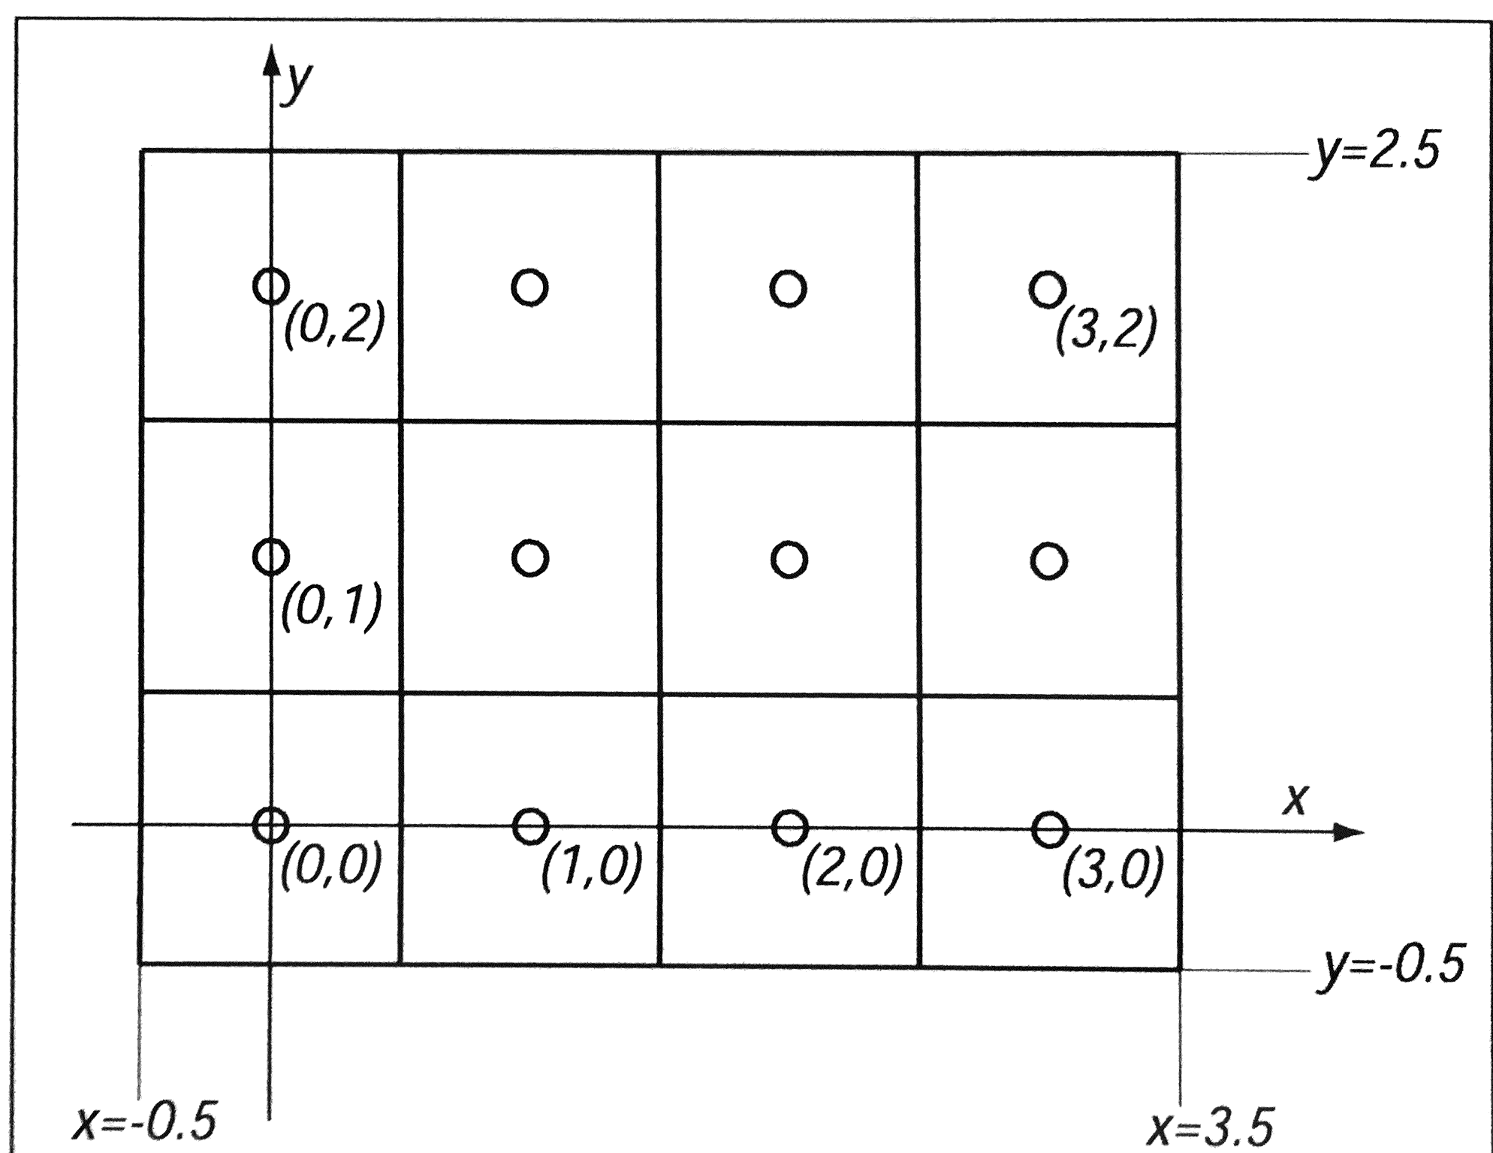
Basic Definitions
Raster: A rectangular array of points or dots.
Pixel: One dot or picture element of the raster
Scan Line: A row of pixels

Slide 3
Example Raster Graphics Architecture
CPU
Peripheral
devices
System bus
GPU/Display
processor
System
memory
Display
processor
memory
Frame
Video
buffer
controller
Monitor
Raster system architecture with a display processor.
(originally from Computer Graphics: Principles and Practice.)

Slide 4
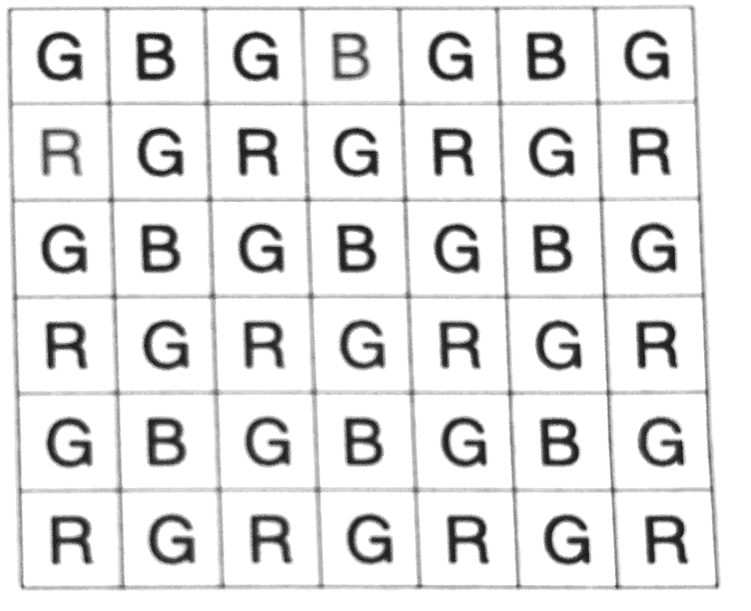
Displays and Cameras
Book covers LED, LCD, ink-jet, dye sub, cameras and scanners
Bayer mosaic

Slide 5
CRT Monitor
CRT
Shadow Mask
Electron Guns
Red Input
Green
Input
Blue Input
Deflection
Yoke
Red, Blue,
and Green
Phosphor Dots

Slide 6
Electron Gun
Stream of electrons directed to front
Num electrons controls brightness
Phosphor, glows briefly
Gaussian distribution of electrons, light

Slide 7
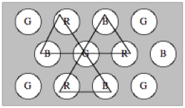
Color CRT
RGB electron guns
Screen coated with phosphor pattern
Fluorescence
Phosphorescence
Persistence

Slide 8
Shadow Mask
Phosphors arranged in triads
Each triad has one R/G/B phosphor dot
Typically 2.3 to 2.5 triads per pixel
Shadow mask has one small hole for each phosphor triad
SHADOW MASK
Phosphor Dot
Screen
Red
Green
Convergence
Blue
Point

Slide 9
Scanning An Image to a Display
Frame: image to be scanned on CRT/LCD
Frame must be “refreshed” to eliminate flicker in the image.
Critical Fusion Frequency
Typically 60 times/sec for raster displays
Varies with intensity, individuals, phosphor persistence, lighting, …

Slide 10
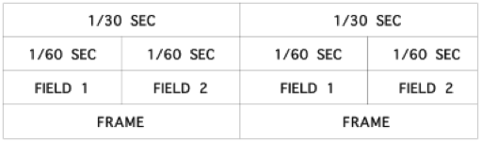
Interlaced Scanning
Assume can only scan 30 times/sec
To reduce flicker, divide frame into two “fields” (odd and even lines)

Slide 11
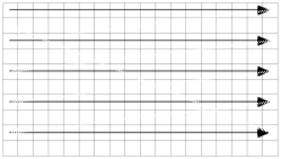
Scanning
VERTICAL SYNC PULSE — Signals the start of the next field.
VERTICAL RETRACE — Time needed to get from the bottom of the current field to the top of the next field.
HORIZONTAL SYNC PULSE — Signals the start of the new scan line.
HORIZONTAL RETRACE — Time needed to get from the end of the current scan line to the start of the next scan line.

Slide 12
Resolution and Addressability
Resolution is a measure of the width of a single line drawn on the CRT screen (1/spotsize). Usually stated as the number of just merged lines per inch or centimeter.
Resolution = Addressability
Addressability is a measure of the spacing between the centers of those lines.
Resolution < Addressability
Smooths out the "jaggies" but the overlap will cause filled areas to be brighter than lines, and lines to be brighter than single pixels.
(Everybody, incorrectly, uses resolution when they mean addressability.)

Slide 13
Frame Buffers
2D array
each (x,y) location = a pixel
Bit Planes, Bit Depth
number of bits in a pixel
Typical frame buffers:
640 x 480 x 8
1280 x 1024 x 8
1280 x 1024 x 24

Slide 14
True Color Display 24 bitplanes, 8 bits R/G/B
2^24 = 16,777,216
N
N
N
Red
Green
Blue

Slide 15
Color Map Look-Up Tables
y
RED
max
GREEN
255
BLUE
1
1
0
y
0
0
67
Pixel displayed
0
1
1001
1010
0001
at x', y'
0
67
100110100001
Pixel in
R
G
B
bit map
0
0
at x', y'
0
x
x
max
Bit map
Look-up table
Display
LUT Video look-up table organization. A pixel with value 67
(binary 01000011) is displayed on the screen with the red electron
gun at 9/15 of maximum, green at 10/15, and blue at 1/15. This look-up
table is shown with 12 bits per entry. Up to 24 bits per entry are
common.

Slide 16
Camera
Aperture
Exposure
Images from https://en.wikipedia.org/wiki/Aperture

Slide 17
Camera Focal Length
field of view = 2 atan (sensorsize / (2f))
http://www.dpreview.com/glossary/optical/focal-length

Slide 18

Aperture, Depth of Field, and Bokeh
"Christmas Tree Lights Bokeh" by Rushilf - Own work
"Josefina with Bokeh" by carlosluis - http://www.flickr.com/photos/paseodelsur/51805888/.

